Slide 1
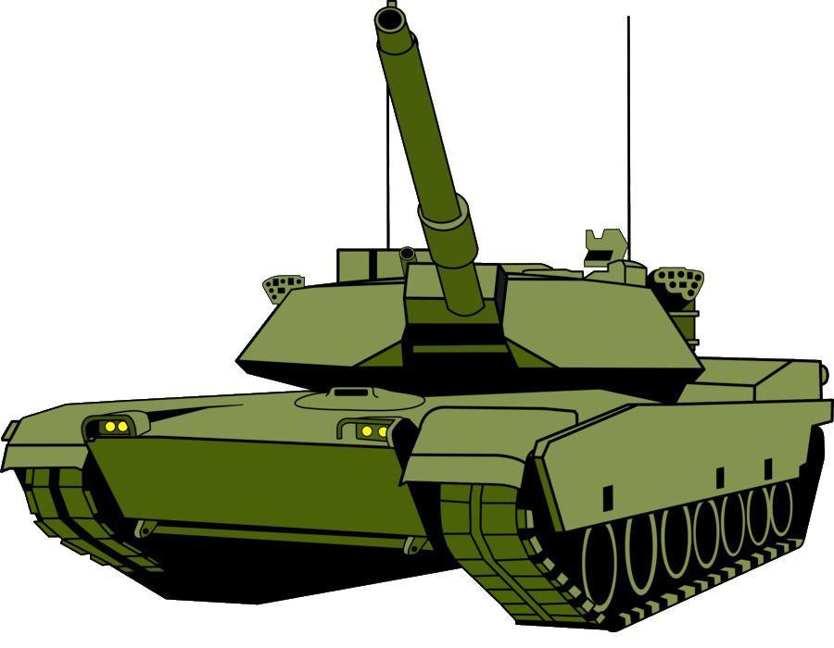
Tanks Game
Carlos Valente​

Slide 2
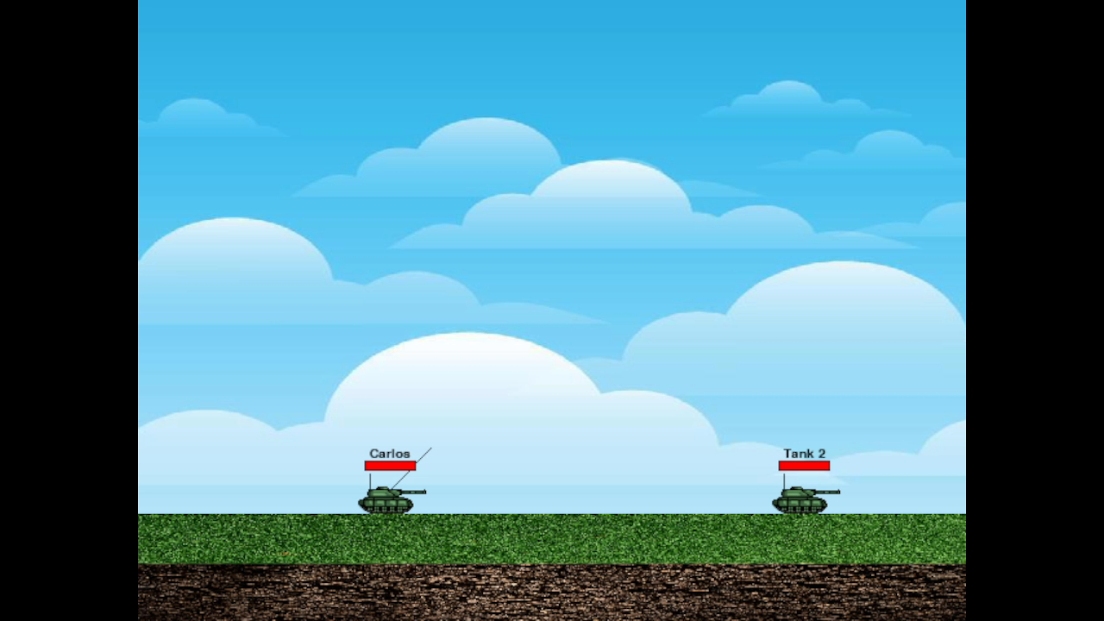
Game Rules
Two players face off on a 2D battlefield
Players take turns moving their tanks or adjusting the angle and power of their missiles
Players fire their missiles when they are ready to attack
The objective is to eliminate the opponent's tank
The player who eliminates their opponent's tank wins the game

Slide 3
File Structure
Input handler
tank
colors
MAIN
bullet
sprites
terrain
fsm
Multicast transceiver

Slide 4
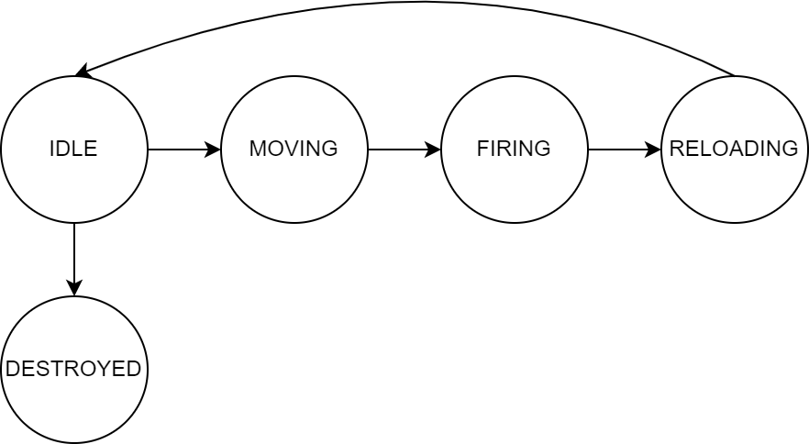
FSM

Slide 5




Main Function
initialization
Input Handler
Game Logic
Rendering
Generates terrain, bullets and tanks objects.
Initializes game variables.
Retrieve and store users key inputs.
Collision handling and out-of-bounds conditions for bullets.
Implementing player-turn decision-making.
Updating game logic.
All sprites, images, and animations are rendered to display.

Slide 6
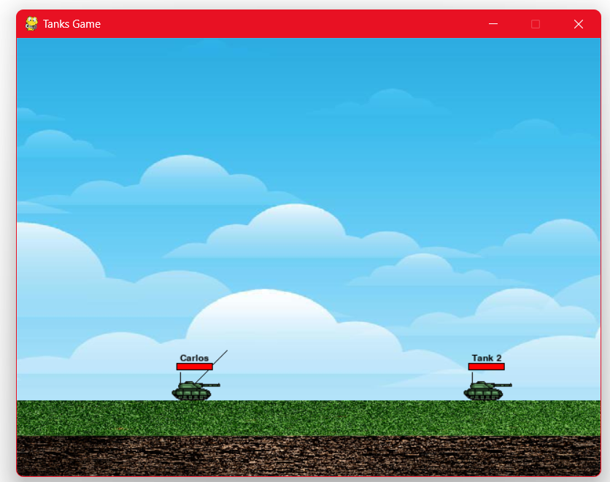
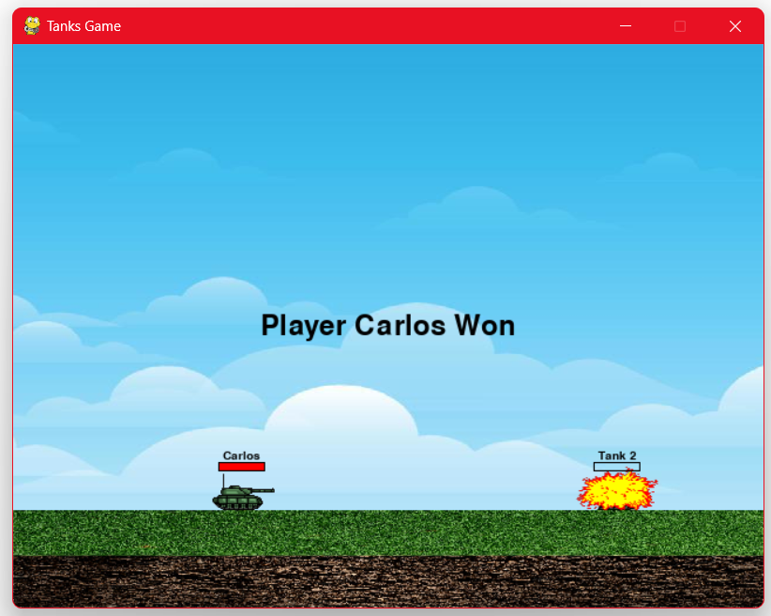
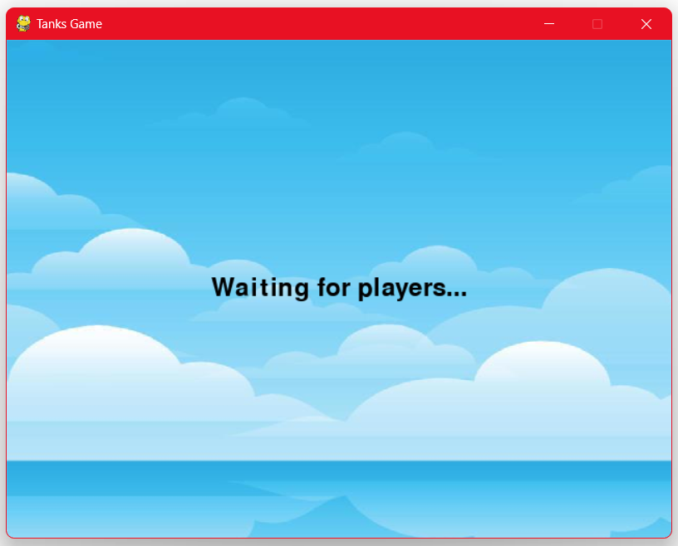
Game Screens
Normal gameplay with 2 players controlling the tanks.
The end screen with the winner’s name presented on screen only happens when one of the tanks is destroyed.
A waiting screen is presented for players in LAN mode waiting for a match.

Slide 7
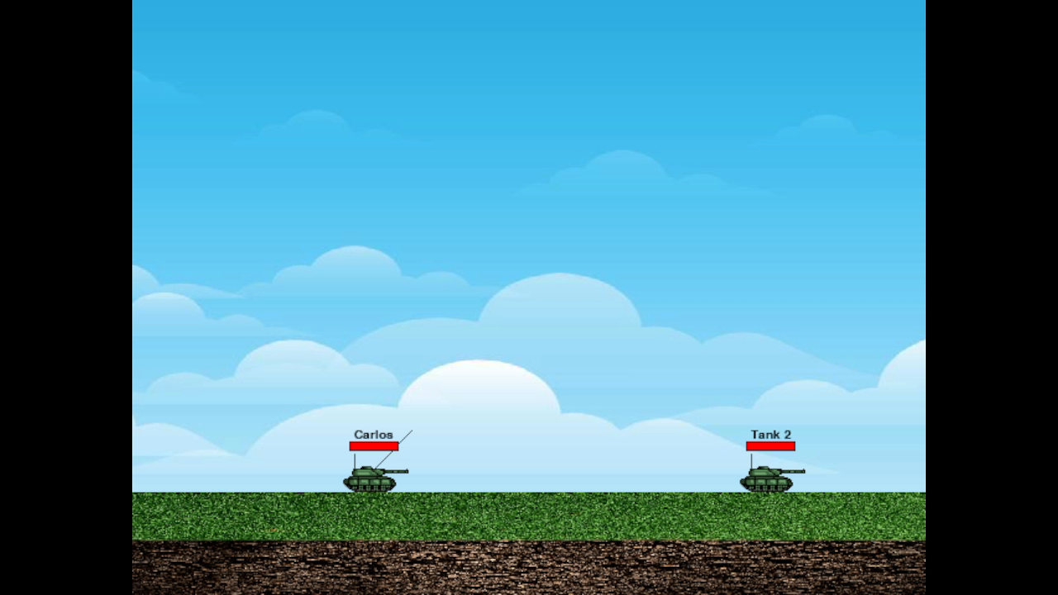
Local GAMEPlay

Slide 8
Patterns
Command
prototype
state
Filters the user’s inputs and maps to the tank’s commands.
Used to generate tanks by cloning a base tank.
Manages the tank’s actions according to the input information gathered.
Double buffer
Game loop
update
Subclass sandbox
Prevents the screen from flickering.
Processes user input, update game elements, and renders to display.
A single method is used to update all sprites on screen.
Sprites, Commands, and Events have a base class to their various subclasses.

Slide 9
Innovative aspects
Collisions
Animations
networking
Bullet collision with the terrain’s surface was implemented by calculating the intersection point of 2 lines.​
Image and sound animation when a bullet hits either a tank or the terrain.
​
Players can play in a Local Access Network (LAN) with other players.
​

Slide 10
Networking
Communication
WAITING
3 message establishment:
WAITING
READY
SYNC
This message is sent when a player is waiting for another player to join the game.
READY
sync
One of the players will be chosen to decide the first player to play and send all information to the other player.
Confirm that both players have the same information before proceeding.

Slide 11
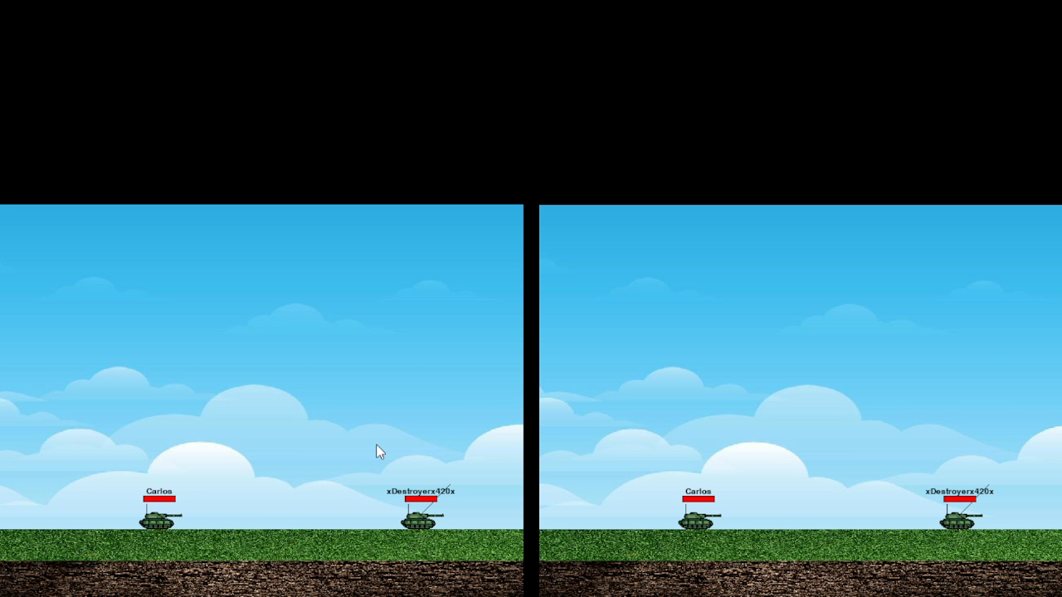
LAN Gameplay
04/01/2023
Tanks game
11

Slide 12
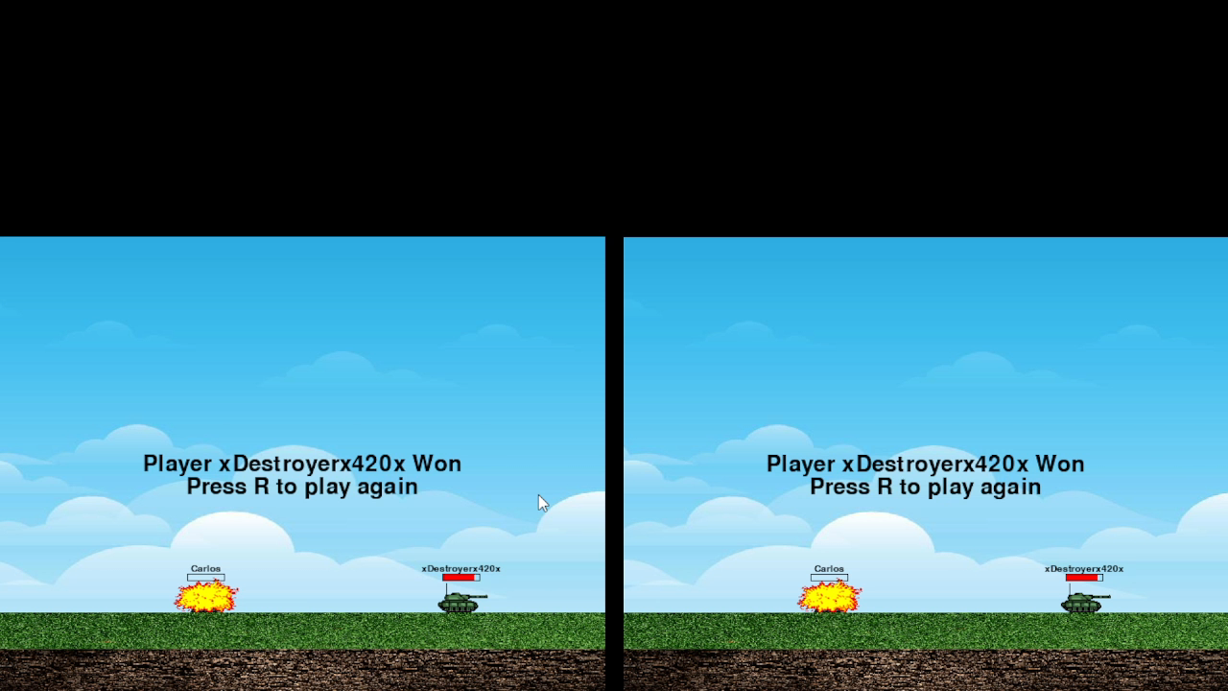
Waiting screen
04/01/2023
Tanks game
12

Slide 13
Future Bug Fixes
Any player can control both tanks.
1
Each tank can move indefinitely across the map.​
2
Tanks can be destroyed when they overlap with another tank.​
3
Networking errors outside of local computer.​
​
4

Slide 14

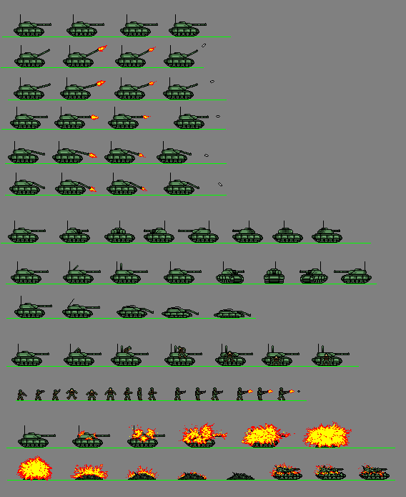

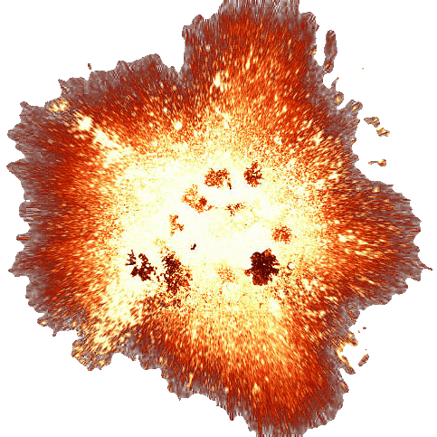


Sky Background
Grass Texture
Explosion Image
Dirt Texture
Explosion Sound
Tanks Spritesheet

Slide 15
Tanks Game
Carlos Valente​

